Slide 1

AI and Sentencing Criminals
Anjelina Shutt, Dylan Waddell, Tyler Vander Mooren

Slide 2
Introduction to AI in Sentencing
AI supports sentencing decisions by estimating the likelihood a convicted person will reoffend and reviewing similar criminal cases to suggest outcomes
Judges incorporate AI recommendations alongside
The prosecutor and defense arguments
The character of the convicted individual
Any unusual circumstances in the case
Advantages: better consistency and reduced human bias
Risks: racial bias, oversimplification, reduced judicial discretion

Slide 3
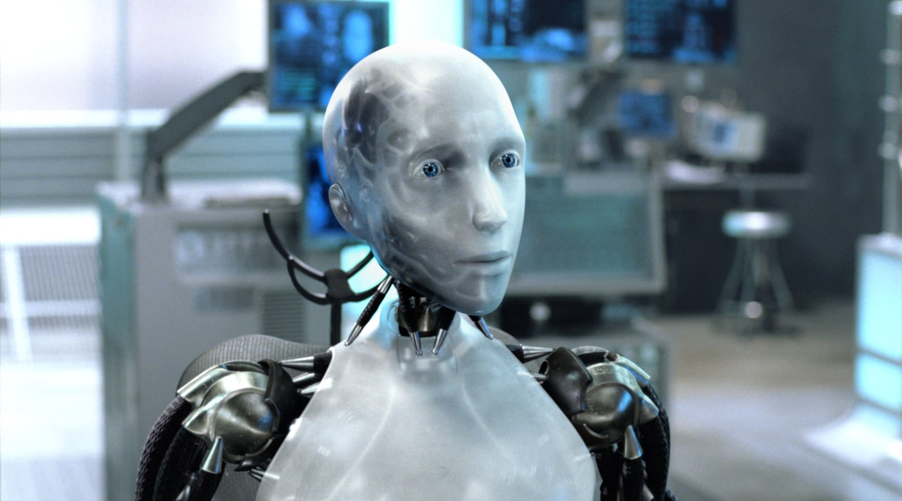
Case Study
Developing an AI system to help judges in sentencing
Analyze characteristics of crimes and criminals
Identify similar past cases for review
Decide whether to display cases, recommend sentences, or both
Understand
The input from judges and lawyers are still important due to experience and knowledge
Ordering of similar cases can affect perceptions
System must comply with legal sentencing requirements

Slide 4
Brainstorm
Stakeholders
Benefits
Judges, defendants, prosecutors, defense attorneys, society, software developers
Faster process and reduced human error or fatigue
Better consistency in sentencing decisions
Risks and Issues
Possible Actions
Racial bias in AI predictions
Over reliance on AI recommendations
Misinterpretation of case or sentencing patterns
System only allows AI to display similar cases, not a full interpretation of the case itself
AI provides case suggestions and recommended sentences

Slide 5
Analysis
Responsibilities
Rights of Stakeholders
Decision making must be fair and comply with the law
Defendant's rights to a fair trial and unbiased sentencing
Judge's right to exercise discretion
Ethical Frameworks Applied
Categorization
Kant: respect human dignity and avoid using individuals as a means to an end
Mill: maximize overall societal benefit
Rawls: ensure a fair and just system for all stakeholders
Ethically Prohibited: allow AI to override human judgment
Ethically Acceptable: AI displays cases and suggests sentences with judge discretion

Slide 6
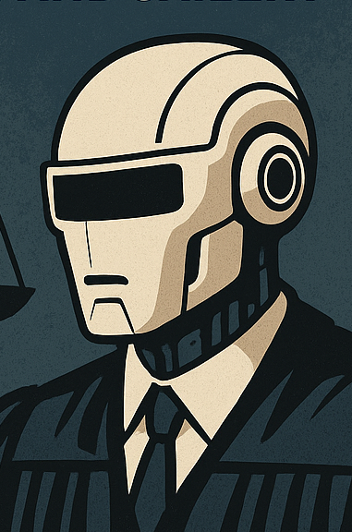
CASE STUDY CONCLUSION
AI can enhance sentencing decisions but cannot replace human judgment.
Ethical development requires
Compliance with laws and ethical codes
Continuous oversight to prevent bias
AI in sentencing criminals reduces bias, creates consistency, and supports judicial decision making without replacing it

